Slide 1


Igor Cornejo
<Date>

Slide 2

Outline
Executive Summary
Introduction
Methodology
Results
Conclusion
Appendix

Slide 3
Executive Summary
Summary of Methodologies
This project applied a full data science workflow to analyze SpaceX Falcon 9 performance and predict successful landings. Data was collected via the SpaceX API and web-scraped from Wikipedia, then cleaned and integrated using the Pandas library in Python. Exploratory analysis was performed using SQL, Seaborn visualizations, Folium GIS mapping, and an interactive dashboard using the Plotly-Dash Python library.
Summary of all results
The analysis covers launches from June 4, 2010 to November 11, 2020. Key findings include the introduction of the fully reusable Falcon 9 Block 5 booster on May 11, 2018 (Flight 54) and a sharp rise in landing success after Flight 40. Most launches occurred from CCAFS SLC-40, followed by KSC LC-39A and VAFB SLC-4E, driven by orbit requirements and crewed vs. uncrewed missions. Multiple machine learning models were trained and evaluated using scikit-learn, including Logistic Regression, SVM, Decision Tree, and KNN. The Decision Tree model delivered the best predictive performance with 89% accuracy.

Slide 4
Introduction
Project background and context
SpaceX has become the dominant leader in commercial spaceflight, driven largely by its breakthrough in reusable rocket technology. As of December 2025, SpaceX lists the price of a Falcon 9 launch at approximately $69.75 million, compared to the $165 million or more typically required for missions using traditional expendable rockets. This cost advantage has reshaped market expectations and intensified competition in the commercial launch sector.
To enter this market, SpaceY aims to analyze publicly available data on SpaceX launches and first-stage landings. A successful SpaceX booster recovery directly reduces launch cost. Predicting landing outcomes is critical for estimating potential cost competitiveness. By leveraging insights from SpaceX’s performance, SpaceY intends to design its own reusable launch system and strategically price missions to compete effectively in the global launch marketplace.
Problem definition
What are the key technical, operational, and environmental factors that determine the success or failure of a Falcon 9 first-stage landing?
Can these factors be systematically analyzed to develop a reliable predictive model?
Which machine learning model delivers the highest accuracy in predicting successful rocket landings?

Slide 5

Section 1

Slide 6
Methodology
Executive Summary
Data collection methodology:
Collected and curated data from the SpaceX REST API and web-scraped the List of Falcon 9 and Falcon Heavy launches from Wikipedia.
Perform data wrangling
Cleaned, standardized, and merged datasets using Python and Pandas.
Perform exploratory data analysis (EDA) using visualization and SQL
Perform interactive visual analytics using Folium and Plotly Dash
Perform predictive analysis using classification models
Trained multiple classification models (Logistic Regression, SVM, Decision Tree, and KNN). Tuned models using scikit-learn's GridSearchCV feature to identify the best model parameters. Selected the best model based on the accuracy score on the test data.

Slide 7
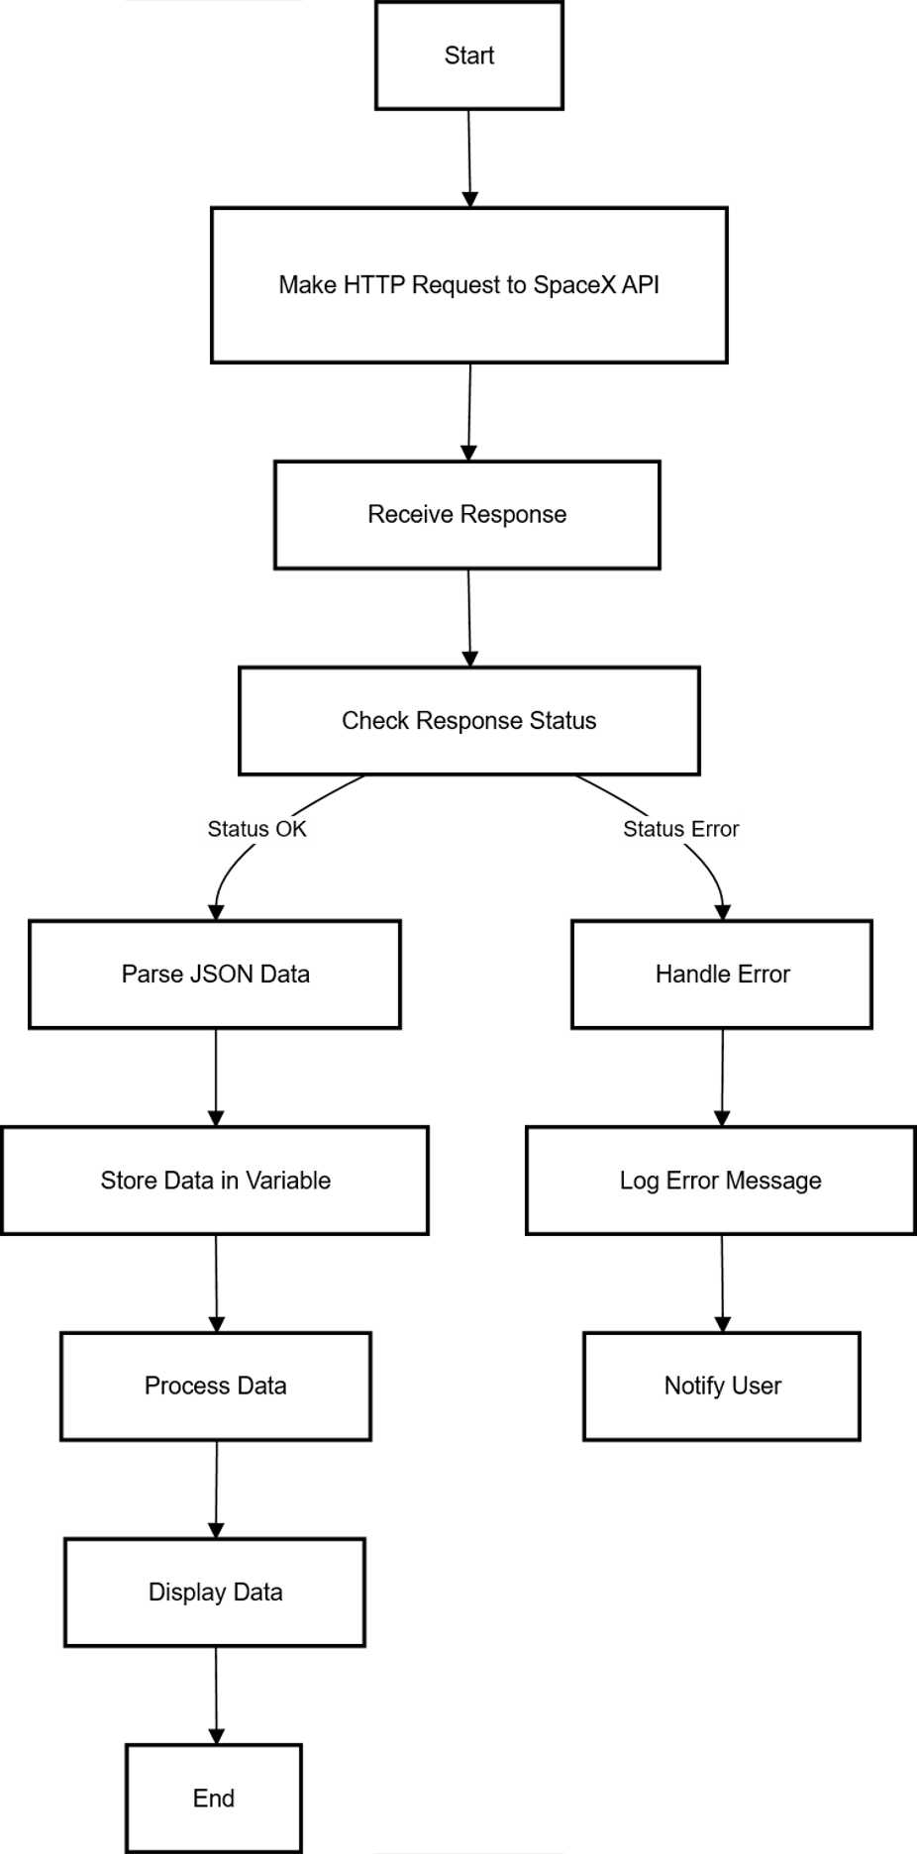
Data Collection – SpaceX API
The following flowchart represents the steps used to download data from the SpaceX REST API.
Refer to notebook: 01_jupyter-labs-spacex-data-collection-api-v2.ipynb to review the detailed steps and processes to download and clean the SpaceX REST API dataset.

Slide 8
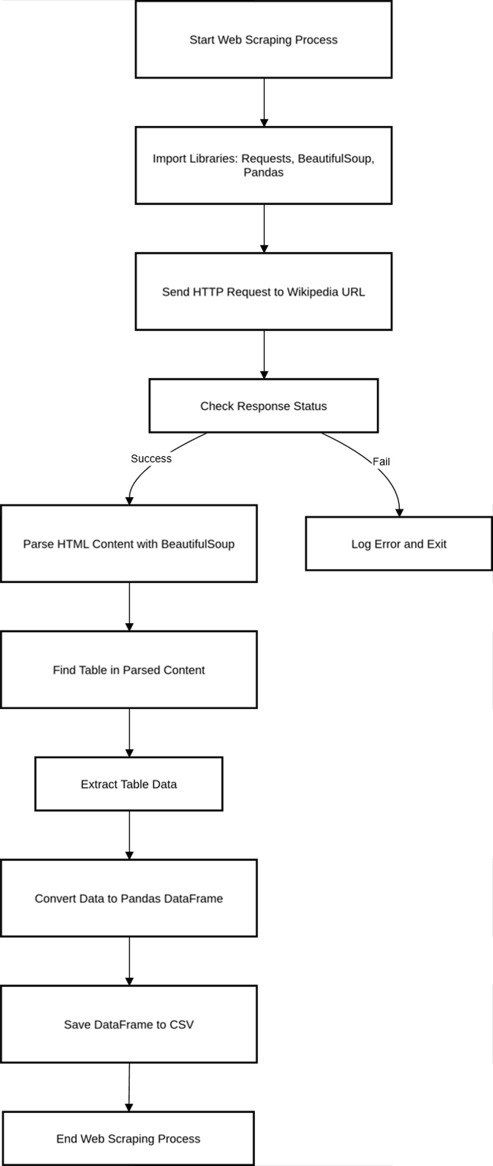
Data Collection - Scraping
The following flowchart represents the steps used to web-scrape data from the Wikipedia website: "List of Falcon 9 and Falcon Heavy Launches".
Refer to notebook: 02_jupyter-labs-webscraping-v2.ipynb to review the detailed steps and processes to scrape the data and create a dataset.

Slide 9
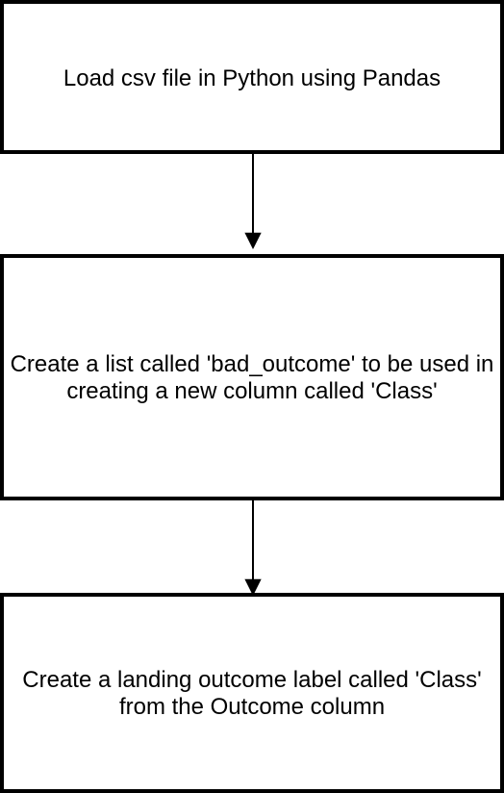
Data Wrangling
For this project, the primary objective of data wrangling is to create a new feature called Class. Class summarizes the launch and landing outcomes found in the dataset into 2 discrete values:
If the booster landing was not successful, Class = 0
If the booster landing was successful, Class = 1
The Class column will be the Target used to analyze and predict launch / landing outcomes.
In addition to creating this Target column, the following operations were performed in this notebook:
Calculate the number of launches on each site
Calculate the number and occurrence of each orbit
Calculate the number and occurrence of mission outcome of the orbits
Refer to notebook: 03_jupyter-labs-spacex-Data wrangling-v2.ipynb to review the details of these calculations and the creation of the Class feature.

Slide 10
EDA with Data Visualization
In order to understand the relationship between dataset features, and identify any correlations to successful landings, the following graphs will be produced:
Categorical Plots
Relationship between Flight Number and Pay Load Mass
Scatter Plots
Relationship between Flight Number and Launch Site
Relationship between Pay Load Mass and Launch Site
Relationship between Pay Load Mass and Orbit
Bar Charts
Relationship between Success Rate and Orbit Type
Relationship between Success Rate and Falcon 9 Blockk Number
Line Graph
Relationship between Year and Success Rate

Slide 11
EDA with Data Visualization
Summary of key findings:
The Falcon 9 booster with the best success rate is the Block 2 booster, followed by the Block 5
However, the only booster designed to be fully reusable is the Falcon 9 Block 5
Refer to notebook: 05_jupyter-labs-eda-dataviz-v2.ipynb for graphs and details

Slide 12
EDA with SQL
The EDA exercise also included performing the following SQL queries on a database created in SQLite, using the csv created by accessing the SpaceX API and web-scraping Wikipedia:
Display the names of the unique launch sites in the space mission
Display 5 records where launch sites begin with the string 'KSC'
Display the total payload mass carried by boosters launched by NASA (CRS)
Display average payload mass carried by booster version F9 v1.1
List the date where the successful landing outcome in drone ship was achieved
List the names of the boosters which have success in ground pad and have payload mass greater than 4,000 but less than 6,000
List the total number of successful and failure mission outcomes
List all the booster_versions that have carried the maximum payload mass. Use a subquery
List the records which will display the month names, successful landing_outcomes in ground pad, booster versions, and launch_site for the months in year 2017
Rank the count of landing outcomes (such as Failure (drone ship) or Success (ground pad)) between the date 2010-06-04 and 2017-03-20, in descending order

Slide 13
EDA with SQL
Summary of key findings:
The first successful drone ship landing was: April 8, 2016
The Falcon 9 Block 5 booster is the only booster version that has carried the maximum payload mass of 15, 600 kg
99 out of 103 launches successfully delivered their payloads into orbit
Refer to notebook: 04_jupyter-labs-eda-sql-edx-sqllite-v2.ipynb for details

Slide 14
Build an Interactive Map with Folium
A GIS analysis was performed using the Python Folium library. The following map objects were used to perform this analysis:
Circles were used to help locate the following regions of interest:
NASA Johnson Space Center
Cape Canaveral Air Force Station Space Launch Complex 40
Kennedy Space Center Launch Complex 39A
Vandenberg Air Force Base Space Launch Complex 4E
Markers and Marker Clusters
Markers were used to mark between successful landings (Green) cs unsuccessful landings (Red), at each launch site.
Marker were also used to identify closest coast line, city, railway, highway and a luanch site
Marker Clusters were used to group landings together in an organized fashion, at each launch site.
Lines
Lines were used to denote distances between launch sites, and closest coast line, city, railway, highway
Property Boundaries
The boundary of each launch site was added as a GeoJSON file to the map
These objects aided in assessing any relationship between launch site and landing success, in addition to logistical planning of transporting material to the launch site.
Refer to notebook: 06_jupyter-labs-launch-site-location-v2.ipynb for details.

Slide 15
Build a Dashboard with Plotly Dash
An interactive dashboard was created using the Plotly Dash Python library
A Pie-chart is used to understand which launch site has the best success rate
Users are able to select between the following launch sites:
All (The % success rate of each launch site as an average of the 3 launch sites)
CCAFS SLC-40 (% Comparison between successful vs. unsuccessful launches)
KSC LC-LC 39A (% Comparison between successful vs. unsuccessful launches)
VAFB SLC-4E (% Comparison between successful vs. unsuccessful launches)
A Scatter-plot is used to understand the relationship between pay load mass and successful launches.
In addition to selecting a launch site, users are able to select a pay load mass between 0 and 9600 kg using a range slider
These plots are meant to understand if there is a relationship between successful launches, payload mass, and booster version for the user selected launch site

Slide 16
Build a Dashboard with Plotly Dash
Summary of key findings:
VAFB SLC-4E is the launch site with the worst success rate
The Falcon 9 Block 5 booster has only launched from KSC LC-39A
Payloads up to 5,500 kg have 100% success rates. Payloads > 5,500 kg have the lowest success rate
Refer to:
Notebook: 07_jupyter-labs-spacex_dash-app.ipynb for details on the code
Spacex-dash-app.py for the python version of the file that can be run as a script

Slide 17
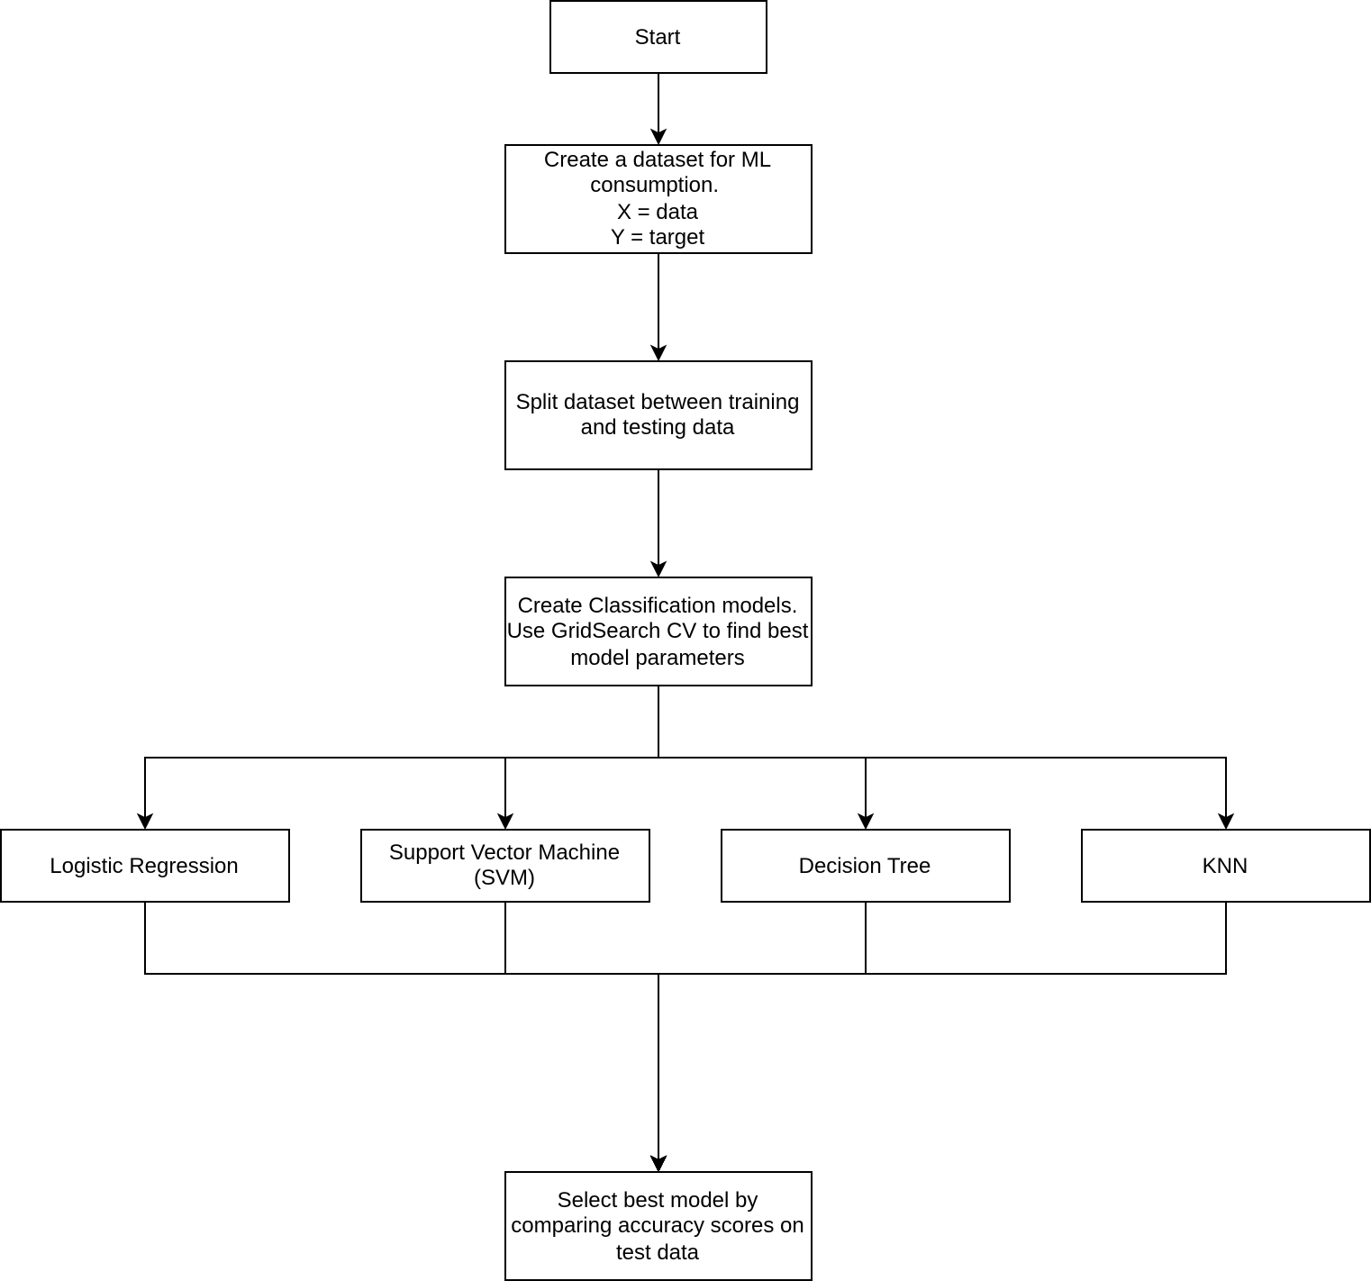
Predictive Analysis (Classification)
The flowchart summarizes the steps and process used to build and select a model
Machine learning models were built using the Scikit-Learn Python library. Scikit-Learn was also used to automate the process of choosing the best model parameters
A model was chosen by comparing model performance accuracy, on test data, and selecting the best performing model
Refer to notebook: 08_jupyter-labs-SpaceX-Machine-Learning-Prediction-Part-5-v1.ipynb for details on model building, and selection

Slide 18
Results
Exploratory data analysis results
The best predictor of a successful landing is the Falcon 9 Booster Version
The Falcon 9 Booster with the best success rate is the Block 2 booster, followed by the Block 5
The Falcon 9 Block 5 is the only booster designed to be fully reusable
The first Block 5 mission was May 11, 2018 (Flight number: 54)
Block 5 rockets have an 85% success rate

Slide 19
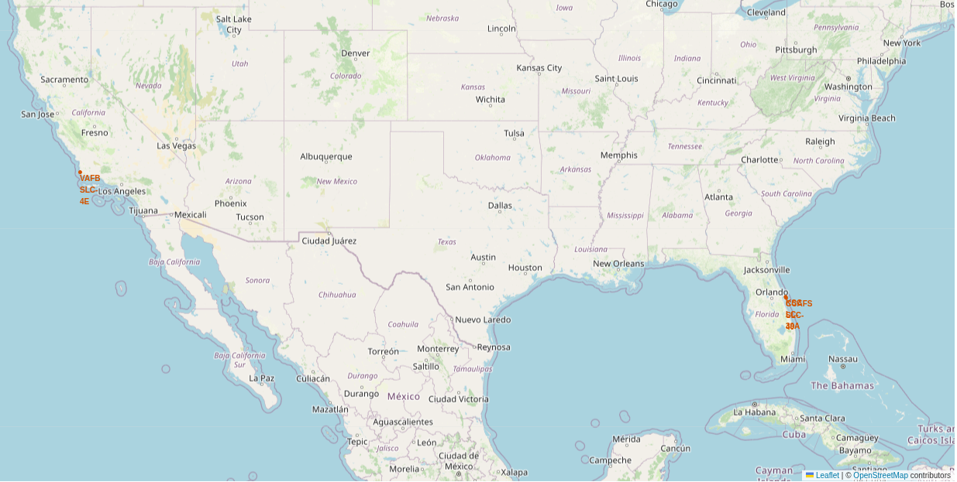
Results
Interactive analytics demo in screenshots
SpaceX uses these 3 launch sites:
Cape Canaveral Air Force Station Space Launch Complex 40 (CCAFS SLC-40)
Kennedy Space Center Launch Complex 39A (KSC LC-39A)
Vandenberg Air Force Base Space Launch Complex 4E (VAFB SLC-4E)
The key driver to selecting a launch site are Orbit and mission requirements

Slide 20
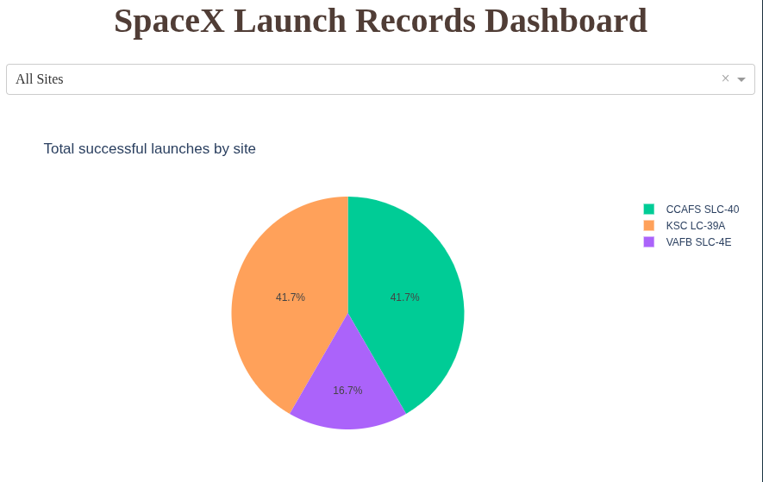
Results
Interactive analytics demo in screenshots
CCAFS SLC-40 and KSC LC-39A have the same success rate

Slide 21
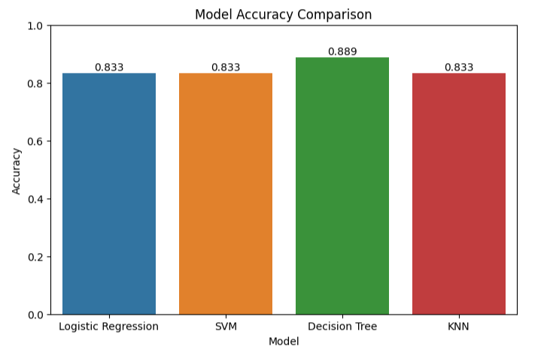
Results
Predictive analysis results
All models performed well
Decision Tree classifier was chosen for having the best model performance

Slide 22

Section 2

Slide 23
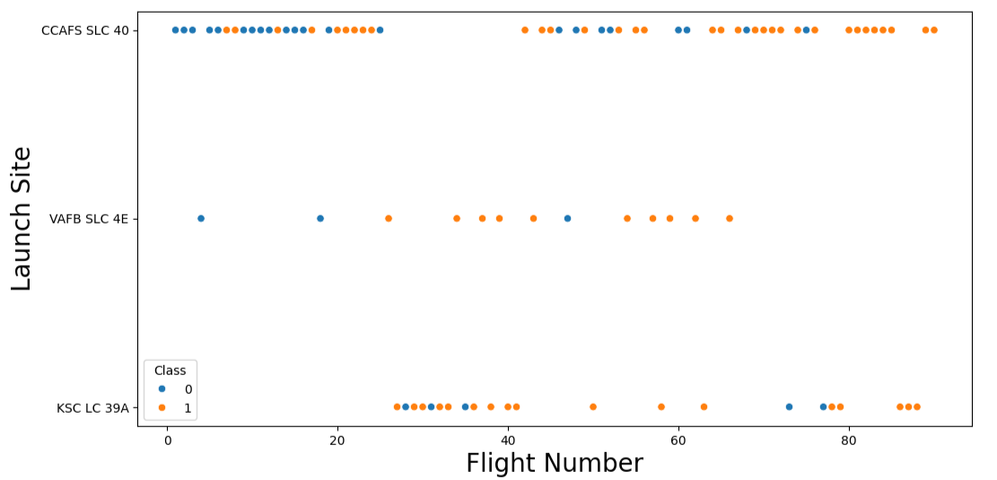
Flight Number vs. Launch Site
Most launches have occurred at SLC-40, followed by LC-39A
As expected, increasing flight numbers increases the likely hood of success
Best success rates are in flight numbers > 40

Slide 24
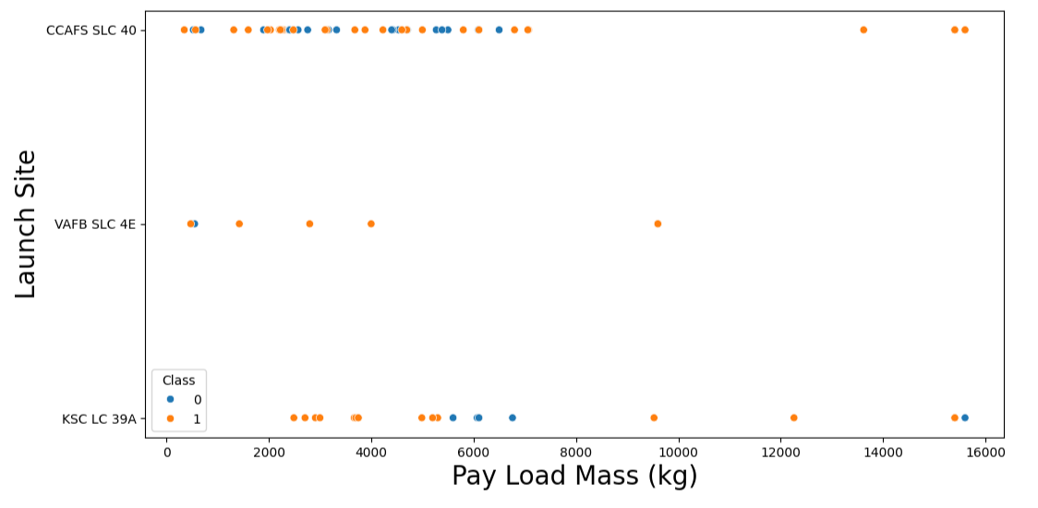
Payload vs. Launch Site
CCAFS SLC-40 has launched the most diverse range of payload mass
There is no correlation between payload mass and launch site

Slide 25
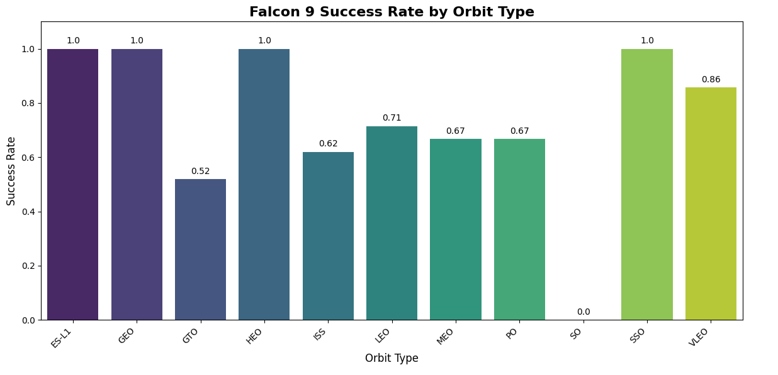
Success Rate vs. Orbit Type
Some orbits have 100% success: ES-L1, GEO, HEO, SSO
To date, launches to SO orbit have not been successful
Orbit should be considered a factor in success
Understanding the frequency of launches to each orbit, and block number would help in better understanding significance of this factor

Slide 26
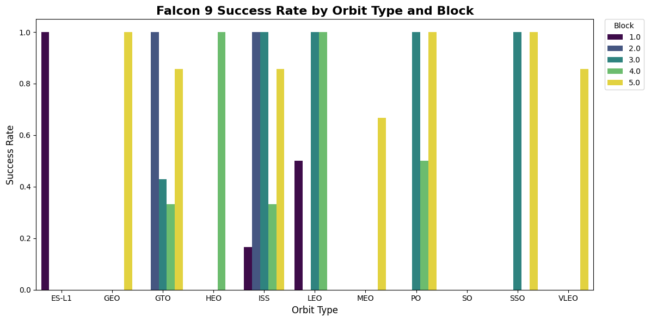
Success Rate vs. Orbit Type and Block
The Block 5 has a high success rate in several orbits
Block 5 boosters is key to having success

Slide 27
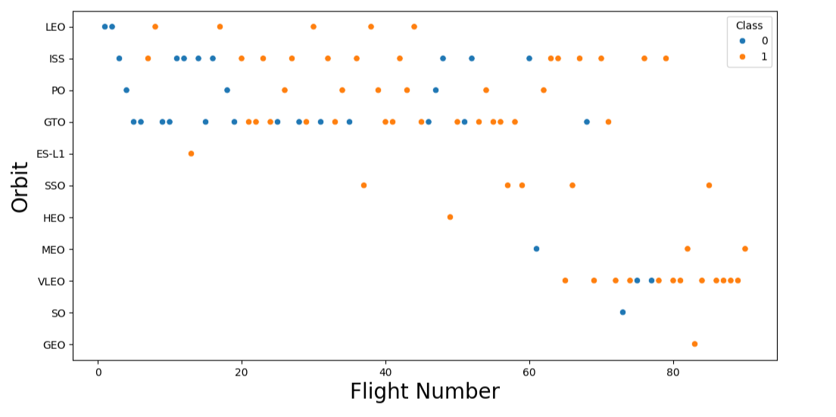
Flight Number vs. Orbit Type
As expected, higher flight numbers have the best chance of success
Flight Numbers > 40 have the most success

Slide 28
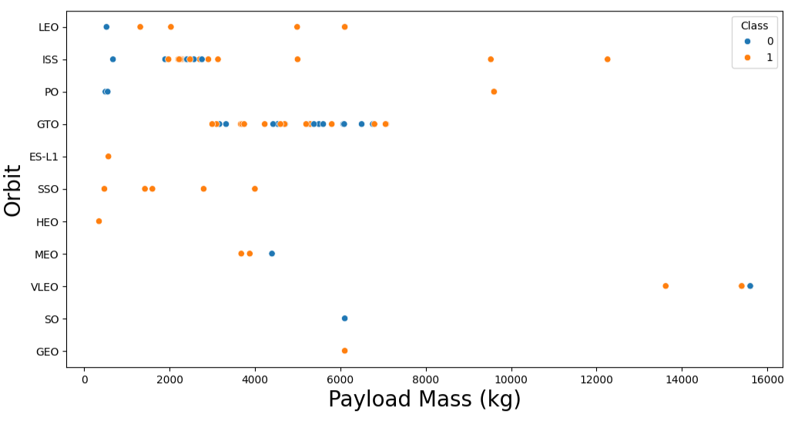
Payload vs. Orbit Type
There is no correlation between Payload Mass and Orbit Type

Slide 29
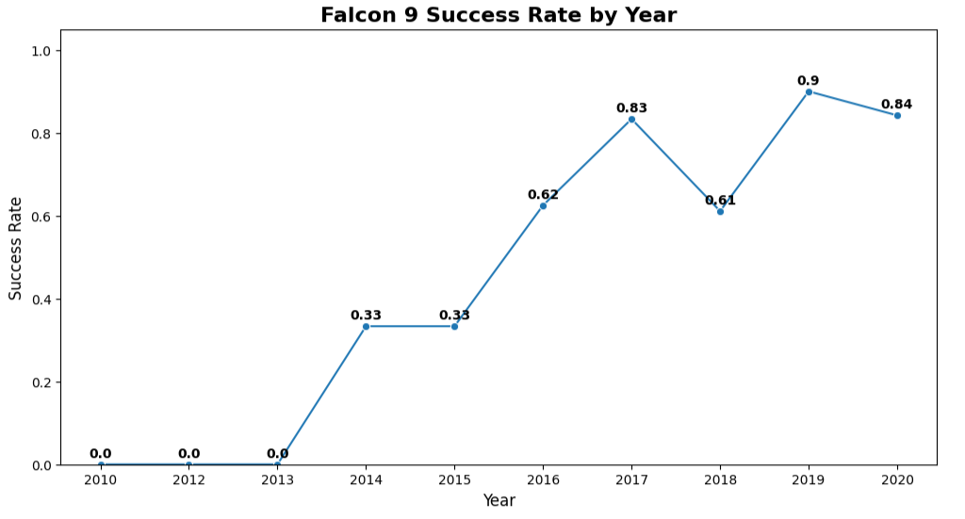
Launch Success Yearly Trend
Since 2013, success rates significantly increased
After 2015, Falcon 9 boosters have had a high success rate
The year over year increase in success rates can be explained by the introduction of new Booster Versions, ones designed to be fully reusable

Slide 30
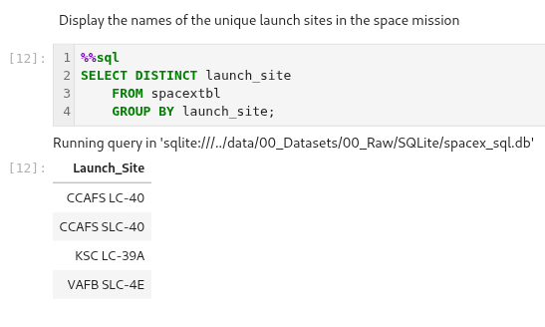
All Launch Site Names
The names of the unique launch sites used by SpaceX Falcon 9 are:
Cape Canaveral Air Force Station Space Launch Complex 40 (CCAFS SLC-40)
Kennedy Space Center Launch Complex 39A (KSC LC-39A)
Vandenberg Air Force Base Space Launch Complex 4E (VAFB SLC-4E)
The following SQL query was used to obtain these results
NOTE: CCAFS LC-40 and CCAFS SLC-40 are the same launch site. LC-40 was renamed SLC-40 when SpaceX started leasing this site

Slide 31
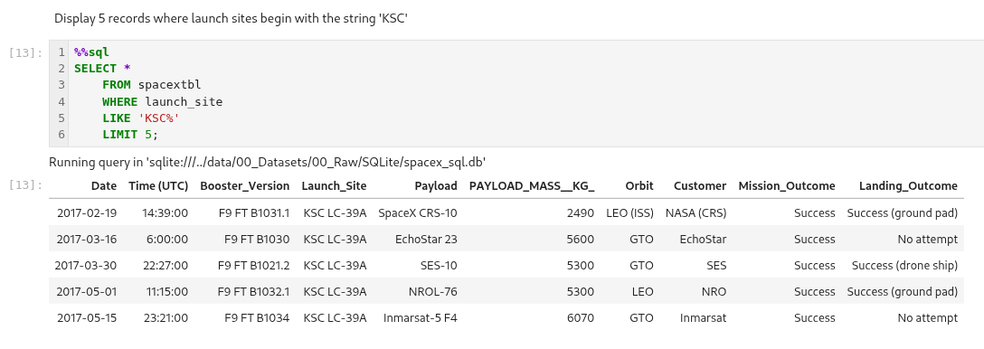
Launch Site Names Begin with 'KSC'
SQL was used to query the database with specific search criteria
Below is a sample query, and the result, of finding Launch Site names that being with 'KSC'

Slide 32
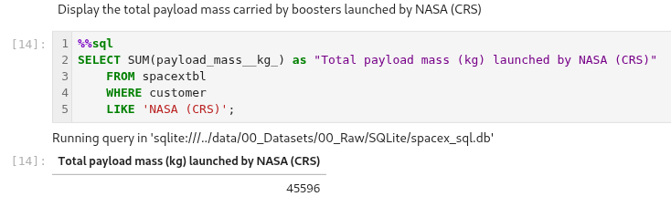
Total Payload Mass
SQL was used to calculate the total mass launched by NASA CRS
Below is the query and the calculated mass (45,596 kg)

Slide 33
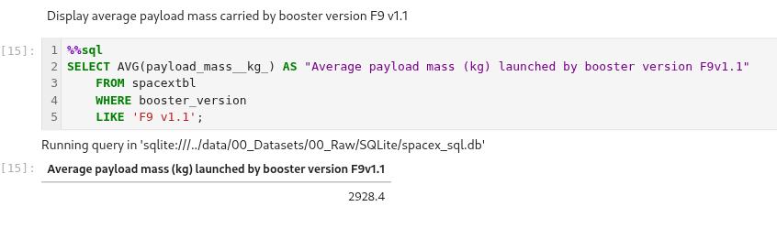
Average Payload Mass by F9 v1.1
Using SQL, we calculated the average payload mass launched by the F9 v1.1 booster version
Below is the SQL and query result (2,928.4 kg)

Slide 34
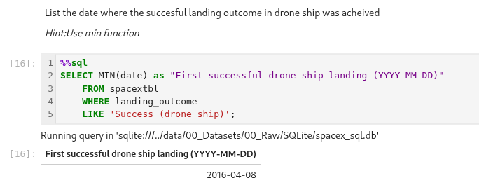
First Successful Ground Landing Date
The database was queried to find the dates of the first successful landing outcome on a drone ship
Below is the query and result (2016-04-08)

Slide 35
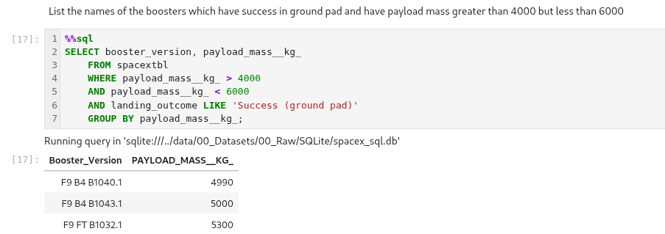
Successful Ground Pad Landing with Payload between 4000 and 6000
The names of boosters which have successfully landed on a ground pad and had payload mass greater than 4000 but less than 6000 is shown below
Below is the SQL query, and query result. Notice the booster versions that have successfully landed on a ground pad are either F9 B4 (Block 4) or F9 FT (Full Thrust).

Slide 36
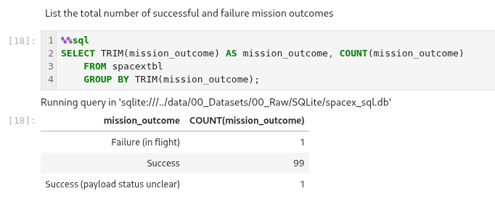
Total Number of Successful and Failure Mission Outcomes
The total number of successful and failure mission outcomes is shown below
The following SQL query, and result, demonstrates the high success rate of SpaceX Falcon 9 boosters

Slide 37
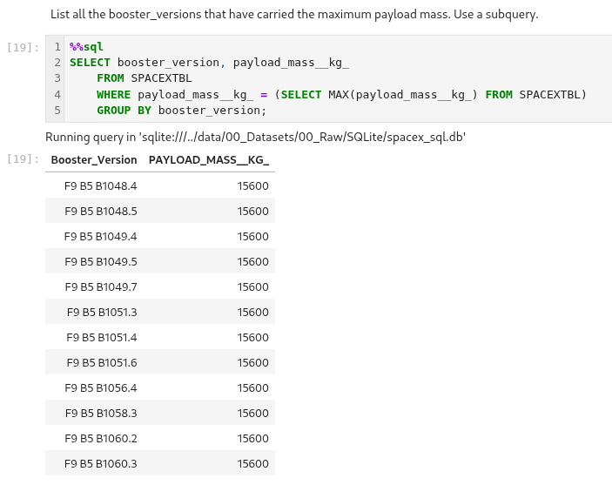
Boosters Carried Maximum Payload
The names of the booster which have carried the maximum payload mass is shown in the following image
The following SQL query, and query result, show the script used to produce the list
Notice that booster version are all Falcon 9 Block 5 (B5) boosters?

Slide 38
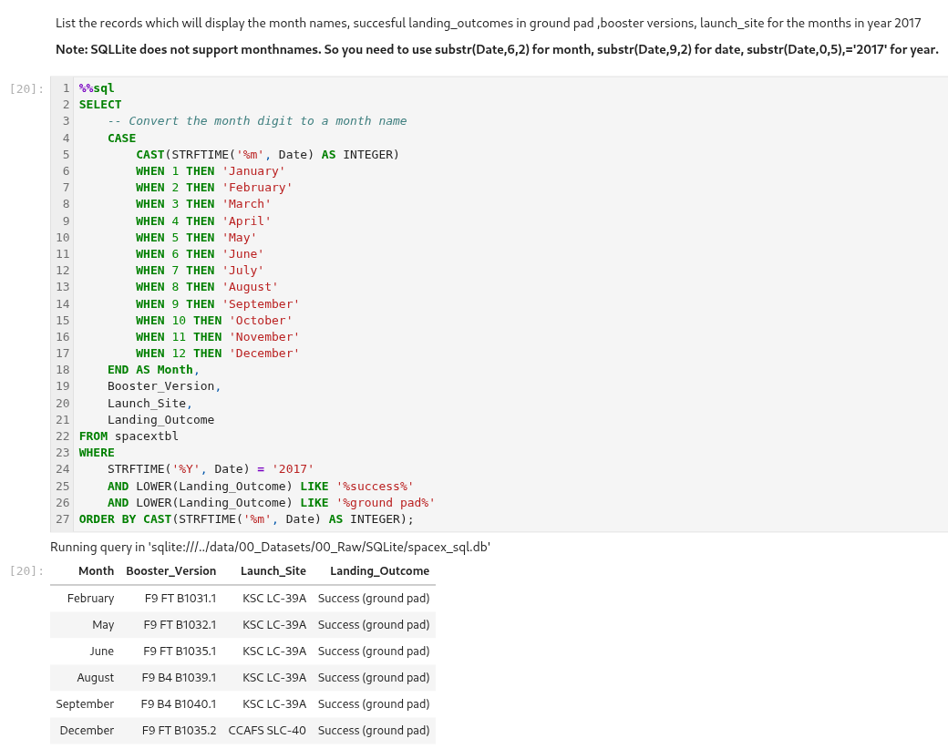
2017 Launch Records
The following image is the output of an SQL query that lists the records containing: successful landing outcomes in ground pad, booster version, and launch site by month in 2017
The complete SQL query is also shown in the image
The majority of these launches were from KSC LC-39A

Slide 39
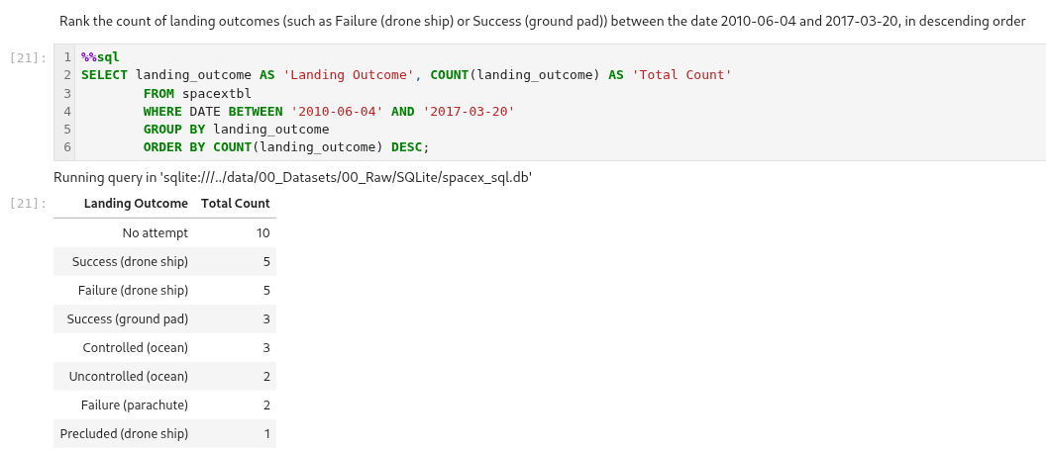
Rank Landing Outcomes Between 2010-06-04 and 2017-03-20
The rank and count of landing outcomes such as, Failure (drone ship) or Success (ground pad)), between the date 2010-06-04 and 2017-03-20, in descending order, is shown in the image
The SQL query and query result is shown in the image
The 'No attempt' is more likely to have occurred between 2010 and 2013

Slide 40

Section 3

Slide 41
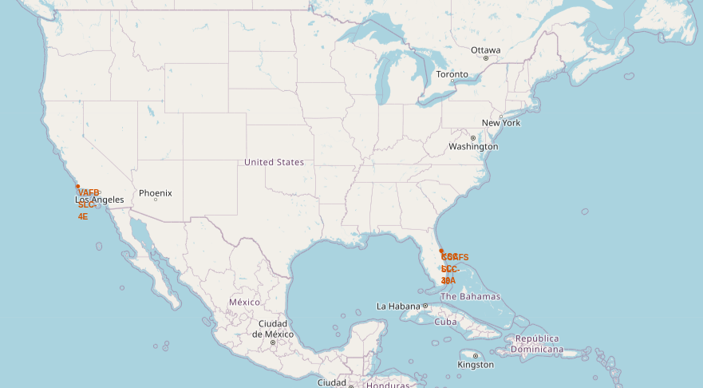
SpaceX Falcon 9 Launch Sites
SpaceX Falcon 9 boosters can be launched from either the west coast or east coast
West coast launches occur at:
Vandenberg Air Force Base (VAFS SLC-4E)
East coast launches occur at:
Cape Canaveral Air Force Station Space Launch Complex 40 (CCAFS SLC-40)
Kennedy Space Center Launch Complex 39A (KSC LC-39A)
The decision on the launch site is based on the Orbit and Mission requirements

Slide 42
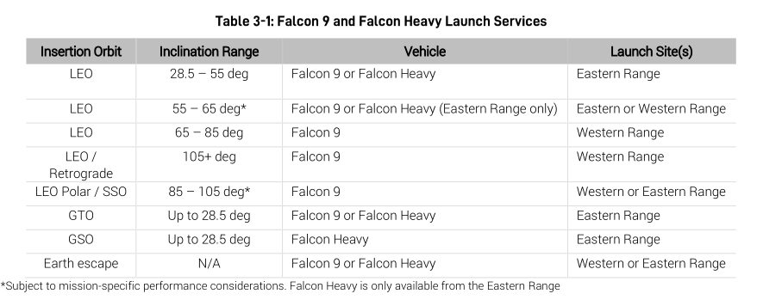
SpaceX Falcon 9 Launch Sites
The following table is from SpaceX' Falcon User's Guide (Version 8)
There are some orbit types that require a specific launch site

Slide 43
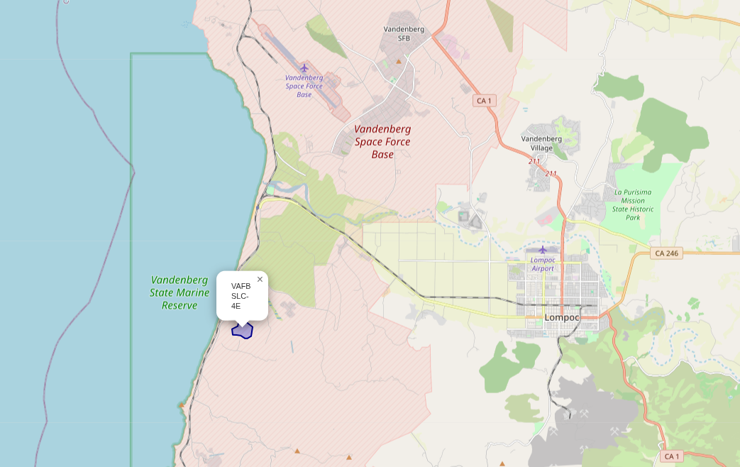
SpaceX Falcon 9 Launch Site – West Coast
Vandenberg Air Force Base (VAFS SLC-4E) is used for LEO orbits that require high inclinations
VAFS SLC-4E can also be used with the following Orbits: PO/SSO, and earth escape trajectories

Slide 44
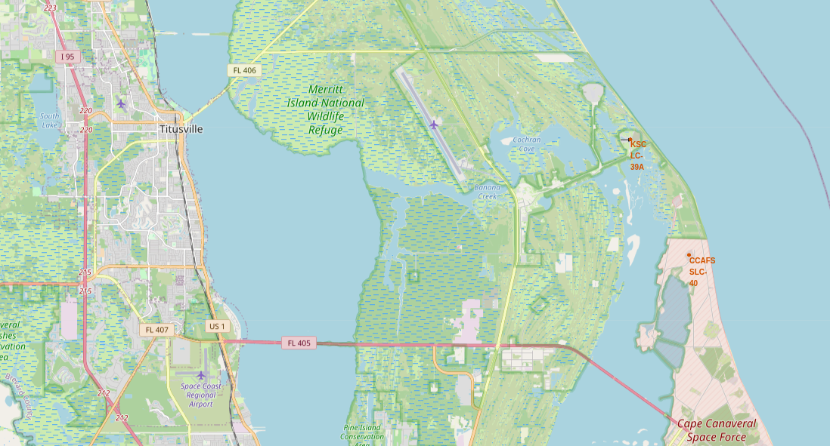
SpaceX Falcon 9 Launch Site – East Coast
East coast launches occur at either:
Cape Canaveral Air Force Station Space Launch Complex 40 (CCAFS SLC-40)
Kennedy Space Center Launch Complex 39A (KSC LC-39A)
KSC LC-39A launches manned Falcon 9 flight missions, missions to the ISS, and Falcon Heavy launches
CCAFS SCL-40 launches all other Falcon 9 missions. Most Falcon 9 launches have occurred at SLC-40

Slide 45
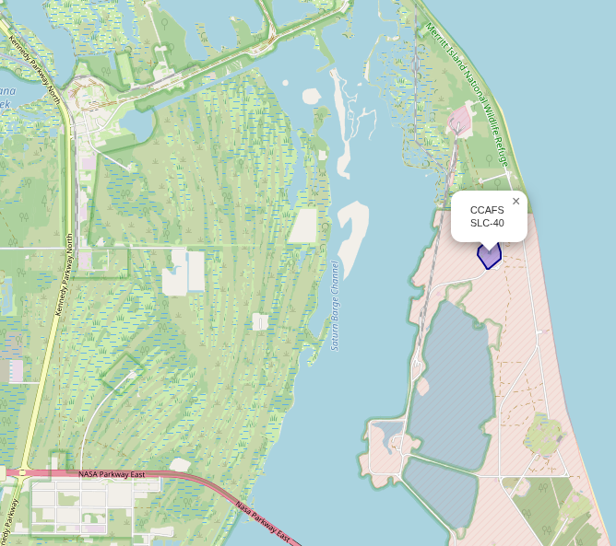
SpaceX Falcon 9 Launch Site – East Coast
CCAFS SLC-40 is SpaceX's work horse launch site
Over 60% of all SpaceX launches have occurred at this launch site
CCAFS SLC-40 is configured to operate a high volume of launches

Slide 46
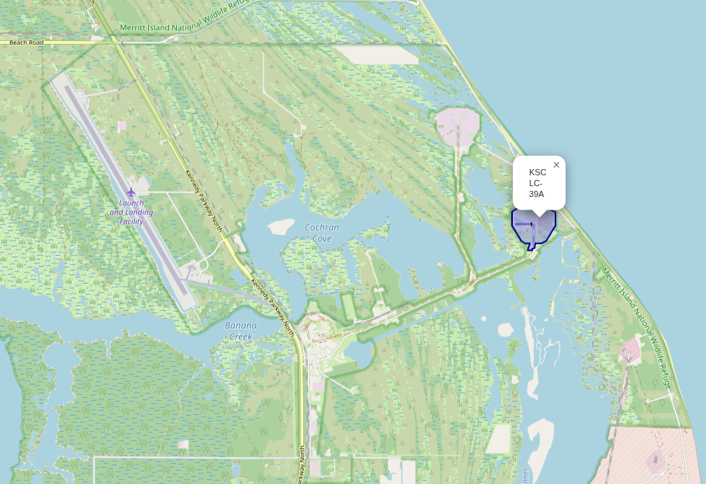
SpaceX Falcon 9 Launch Site – East Coast
KSC LC-39A is configured to handle manned crews
This launch site was previously used by the Space Shuttle and Apollo space programs
Today SpaceX also uses this launch site for missions to the ISS, and Falcon Heavy launches

Slide 47
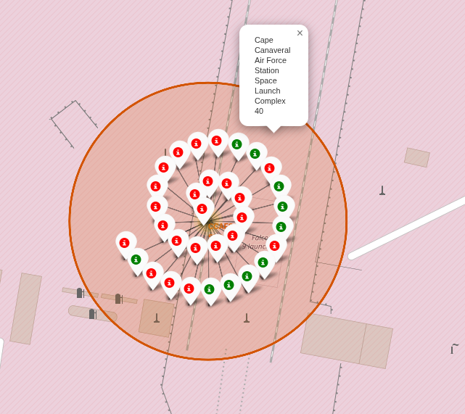
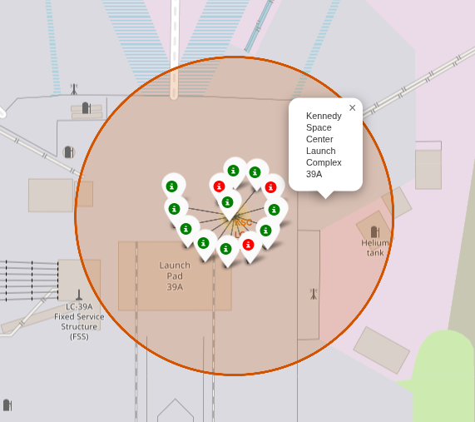
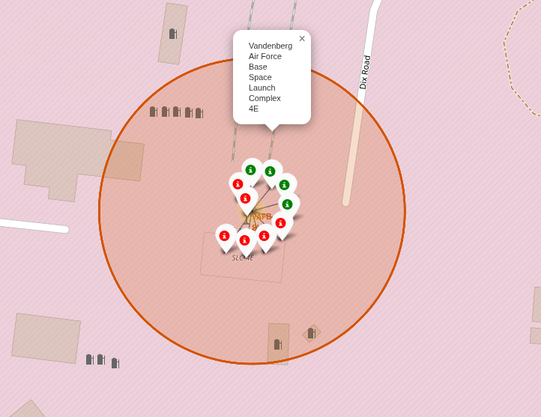
Launch Count and Outcome by Launch Site
The total launches at each launch site have been color coded:
Red = Unsuccessful landing
Green = Successful Landing
SLC-40 has launched the most rockets, LC-39A has the best success rate
CCAFS SLC-40
KSC LC-39A
VAFB SLC-4E

Slide 48
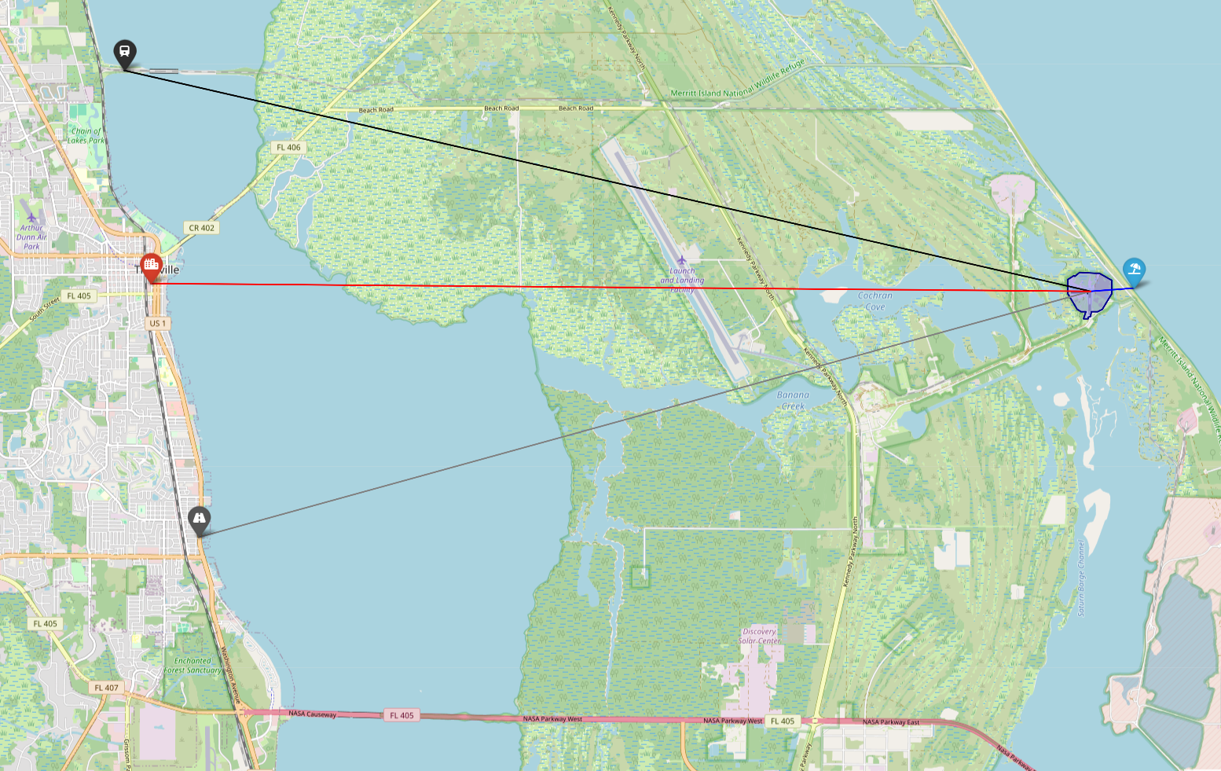
KSC LC-39A Proximity to railway, highway, and coastline
KSC LC-39A was previously used by the Space Shuttle and Apollo programs
This makes KSC LC-39A an ideal launch site, given the in-place infrastructure that can be used to transport and assemble rocket components and payload at this site

Slide 49
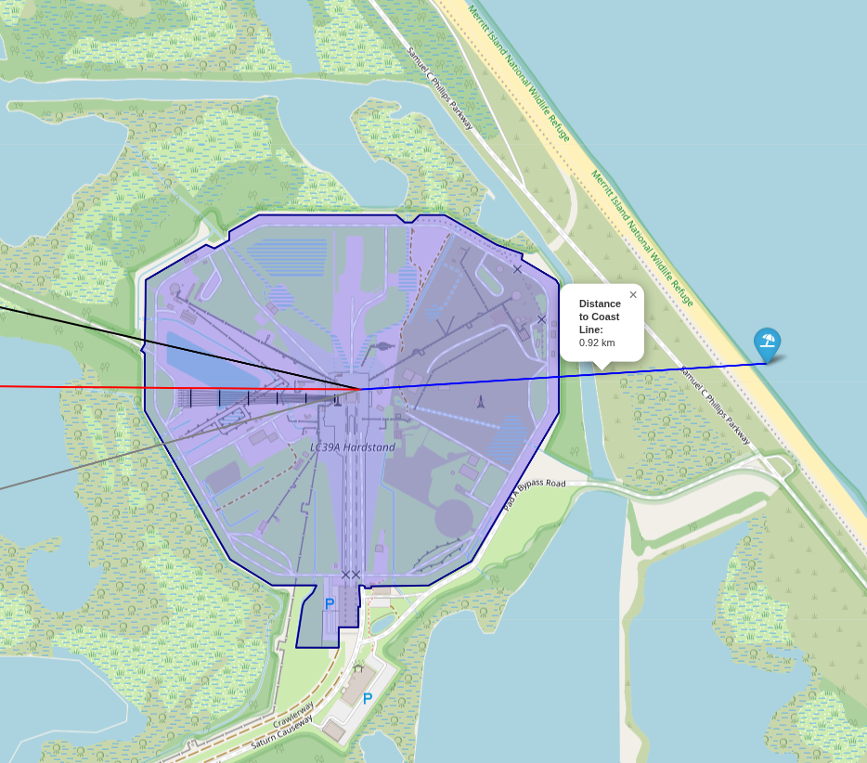
KSC LC-39A Proximity to railway, highway, and coastline
The distance from KSC LC-39A to the coast is 0.92 km

Slide 50
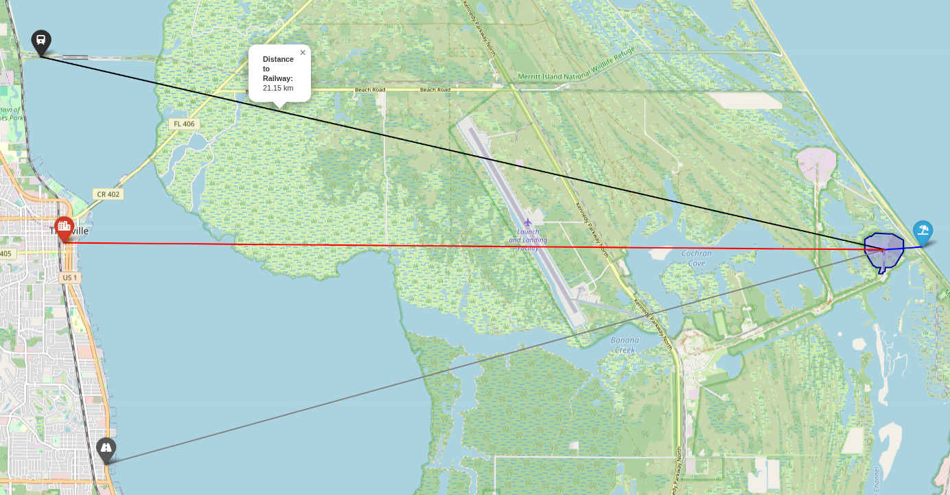
KSC LC-39A Proximity to railway, highway, and coastline
The distance from KSC LC-39A to the closest railway hub is 25 km

Slide 51
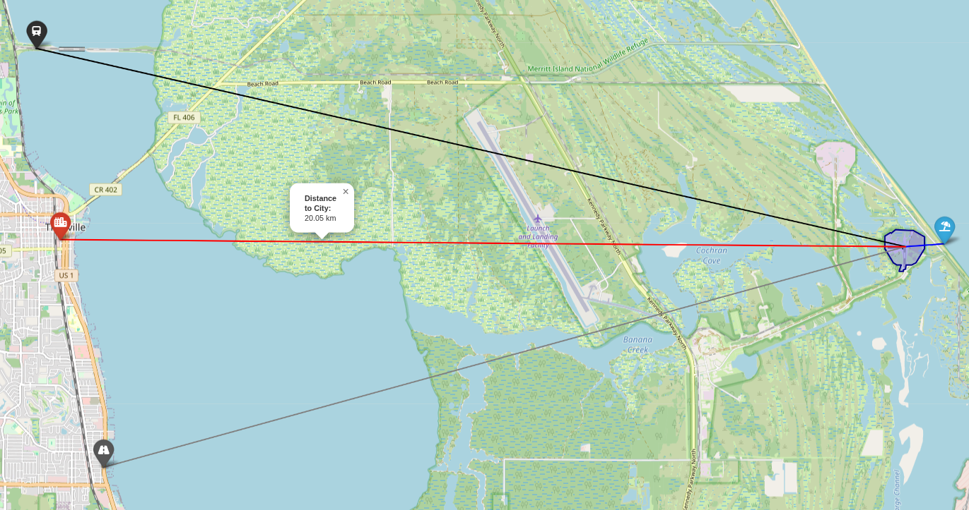
KSC LC-39A Proximity to railway, highway, and coastline
The distance from KSC LC-39A to the closest city (Titusville) is 20 km

Slide 52
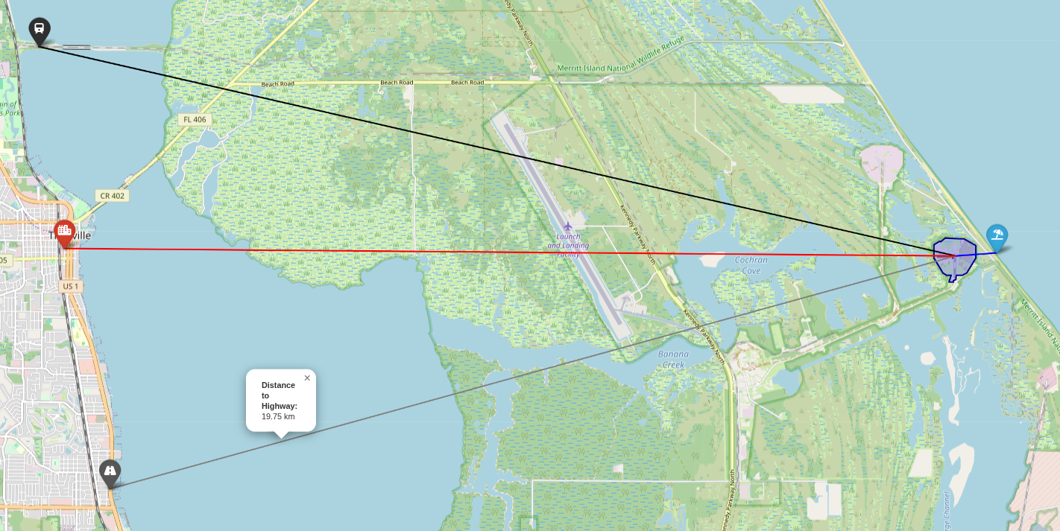
KSC LC-39A Proximity to railway, highway, and coastline
The distance from KSC LC-39A to the closest highway is ~20 km

Slide 53

Section 4

Slide 54
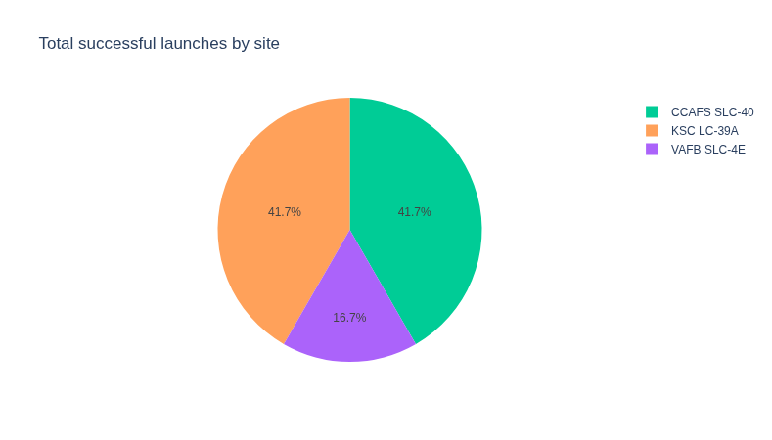
Successful launches by site
CCAFS SLC-40 and KSC LC-39A have the same launch success rate
The breakdown of total launches by site is:
CCAFS SLC-40 = 33
KSC LC-39A = 13
VAFB SLC-4E = 10
The success rate is expected to significantly improve once SpaceX has fully migrated all its Falcon 9 boosters to the Block 5 version

Slide 55
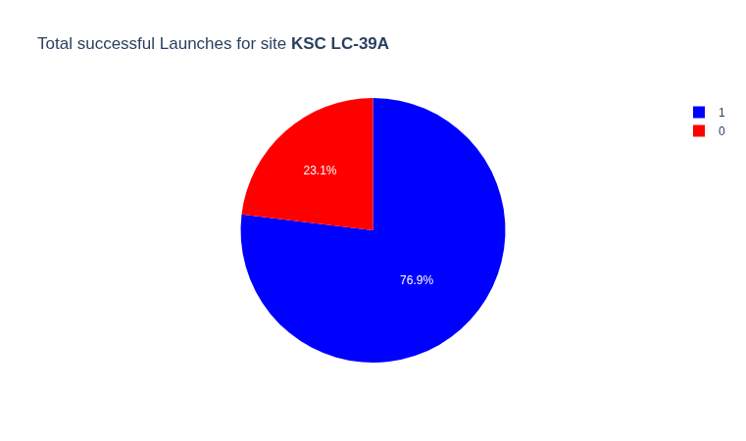
Launch site with highest success ratio
KSC LC-39A is the launch site with the highest success ratio
Out of a total of 13 launches, there were 10 successful launches, with a success ratio of 10:13
There were only 3 unsuccessful launches
The success ratios for the other launch sites are:
CCAFS SLC-40 (10:33)
VAFB SLC-4E (4:10)

Slide 56
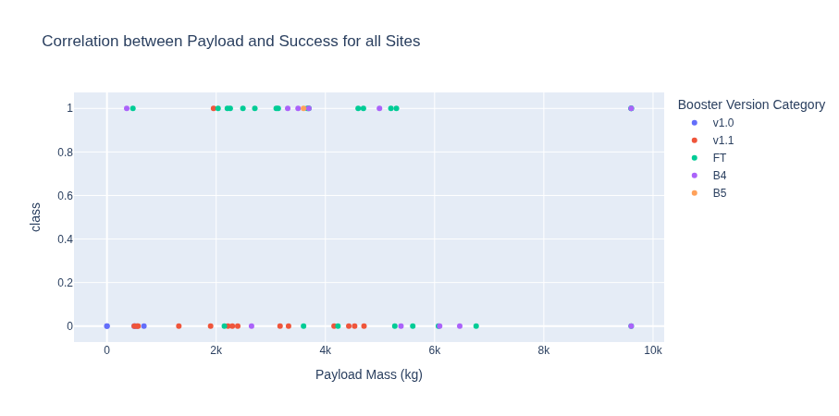
Payload Mass (kg) and Success Rate (All Launch Sites)
This dataset contains a total of 56 launches
The overall launch success rate is 0.43
The overall success ratio is 3:7
The low success rate is explainable by the number of test boosters vs. production boosters found in the data set
The B4 and B5 boosters are the only Falcon 9 boosters designed to be reusable. The B5 is the only booster designed to be fully reusable

Slide 57
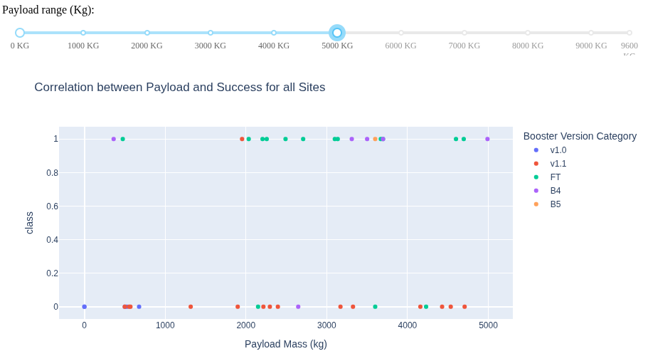
Payload Mass (<= 5000 kg)
There have been a total of 42 Falcon 9 launches with a payload mass <= 5000 kg
The overall launch success rate is 0.45
The overall success ratio is 19:42
7 of these launches were either B4 or B5 boosters
The overall launch success rate is 0.86
The overall success ratio is 6:7

Slide 58
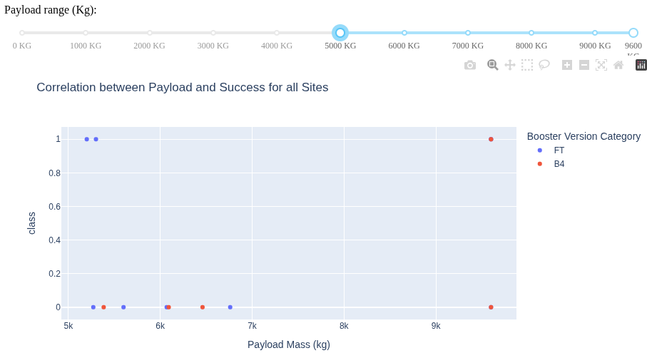
Payload Mass (>= 5000 kg)
There have been a total of 14 Falcon 9 launches with a payload mass >= 5000 kg
The overall launch success rate is 0.36
The overall success ratio is 5:14
5 of these launches were B4 boosters (no B5 in this range)
The overall launch success rate is 0.20
The overall success ratio is 1:5

Slide 59
Observations
According to the data, the best likelihood of a successful launch is using a Falcon 9 B5 booster carrying a Payload Mass up to 5000 kg

Slide 60

Section 5

Slide 61
Classification Accuracy
4 classification models were built and trained
The Decision Tree classifier was the best performing model, as is the recommended model to use in deployment

Slide 62
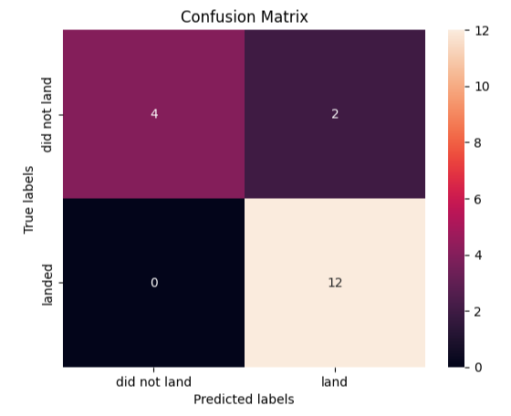
Confusion Matrix
The Decision Tree classifier performed better at predicting unsuccessful landings (TP) in comparison to the other classifiers
This classifier also had a better (lower) score in False Negative (FN) perdictions

Slide 63
Conclusions
The Falcon 9 Block 5 booster version is the most critical feature to predicting a successful booster landing
The success rate of the Block 5 booster is 0.85, success ratio is: 33:39
The first Block 5 mission was May 11, 2018 (Flight number: 54)
The Block 5 booster is the only Falcon 9 booster version designed to be fully reusable
It only took SpaceX 8 years to design a fully reusable booster
Other factors like: Launch Site location, orbit, and payload mass did not make a significant difference to success outcomes, especially when considering that the first few booster versions were proof of concept designs, not production versions
A machine learning model was built to predict landing outcomes, with an accuracy of 89%
The model needs to be updated quarterly (every 3 months as a minimum), ensuring most recent launch data is incorporated in model predictions
Considering the amount of Block 5 boosters currently in service, future analytics and machine learning projects should consider calculating the probability of success based on: payload mass, orbit, number of booster reuses, and any date related historical trends or patterns

Slide 64
Appendices
Appendix 1 – Working with SQL in a Jupyter Notebook
Appendix 2 – Working with months in SQLite
Appendix 3 – Falcon 9 Success Rate by Orbit Type and Block
Appendix 4 – Falcon 9 Success Rate by Block
Appendix 5 – Base maps of launch locations
Appendix 6 – Orbits vs. Launch Locations
Appendix 7 – Building a Tree Classifier model

Slide 65
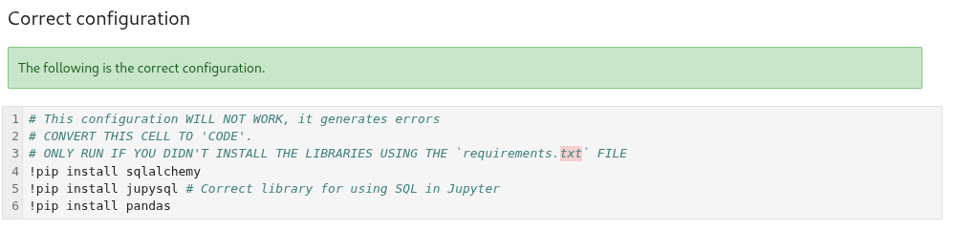
Appendix 1 – Working with SQL in a Jupyter Notebook
There is an error in the Hands-on Lab: Complete the EDA with SQL notebook. Below are the correct libraries to install:
Please refer to the notebook for complete details

Slide 66
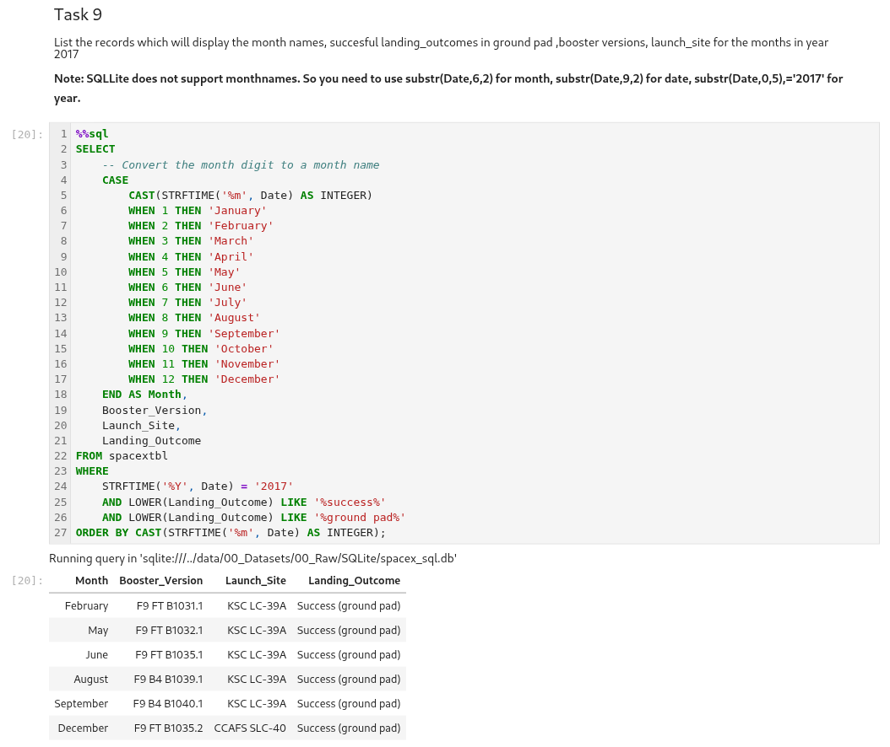
Appendix 2 – Working with months in SQLite
The following SQL script was used to complete the task of displaying sorting data by month in SQLite
Please refer to the notebook for complete details

Slide 67
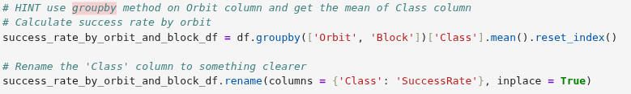
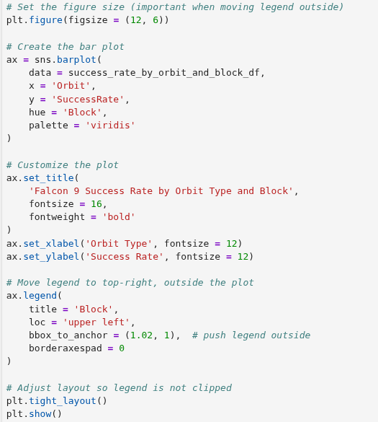
Appendix 3 – Falcon 9 Success Rate by Orbit Type and Block
The following script was used to create a relationship of success rate by orbit type and block
It clearly demonstrates the high success rate of the Block 5 booster
Refer to the notebook for details

Slide 68
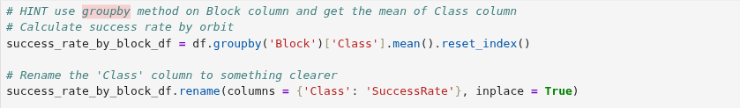
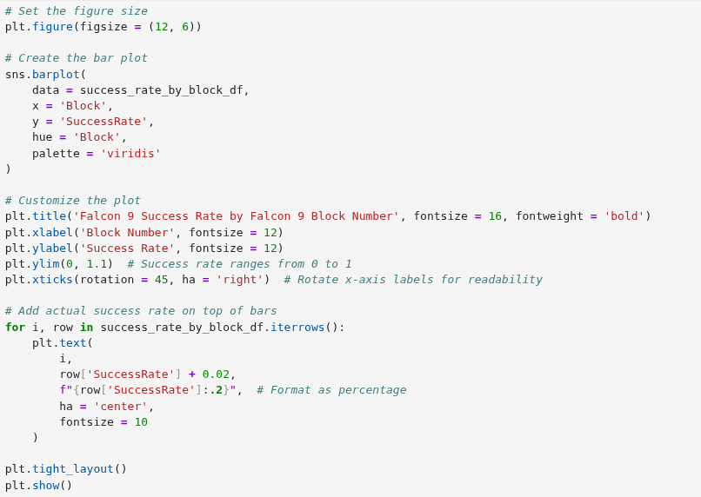

Appendix 4 – Falcon 9 Success Rate by Block
The following script was used to create a relationship of success rate by block
It shows the high success rate of the Block 5 booster
Refer to the notebook for details

Slide 69

Appendix 5 – Base maps of launch locations
In order to enhance the analytics, base maps of each launch location was obtained. The following script and base map is the CCAFS SLC-40 location
The basemaps come from Overpass Turbo, an open source website containing GIS data
Refer to the notebook for details

Slide 70
Appendix 6 – Orbits vs. Launch Locations
The following table was used to understand the relationship between launch site and orbit requirements
The table is from SpaceX's Falcon User's Guide (Version 8)
A local copy of this guide can be found here
Refer to the guide for details

Slide 71

Appendix 7 – Building a Tree Classifier model
The following scripts were used to create a decision tree classifier
Some modifications were needed to the originally provided scripts, due to changes in more recent versions of Scikit-Learn
Refer to the notebook for details

Slide 72


